Slide 1
Drink and Delight Inventory Management
Submitted by:
Group D
Rohit kumar
Ritwik sinha
Maski Saijahnavi
Sowrasree Banerjee
Pushpraj Kaushik

Slide 2
Epics and user stories
Epic 1: As a system user I need to perform Order processing.
User stories:
As a system user , I need to login in the system
I need to get information about all the recent orders
I need to send request for available product count
Based on the product count , I will start shipping the products to the distributor.

Slide 3
Epic 2: As a distributor I need to update my address
User stories:
As a distributor I need to login into system
I need to raise the request to the system for adding, updating and deleting.
The system will add, update or delete the address based on his request.
The system will send me message whether the address is deleted ,updated or added.

Slide 4
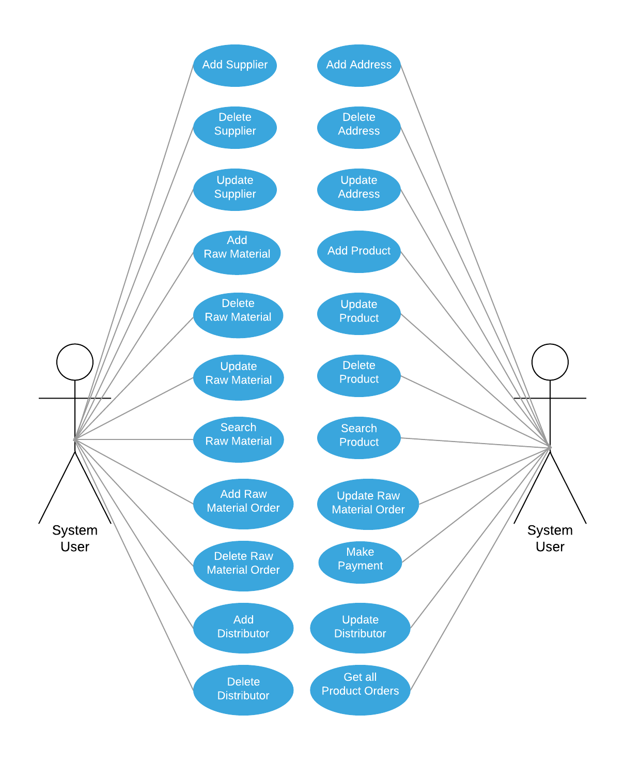
Use case Diagram for system user

Slide 5
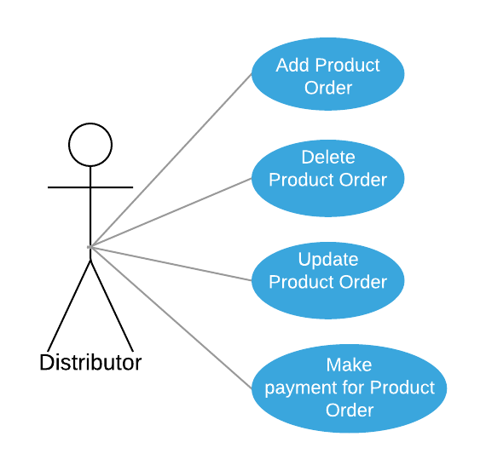
Use case Diagram for Distributor

Slide 6
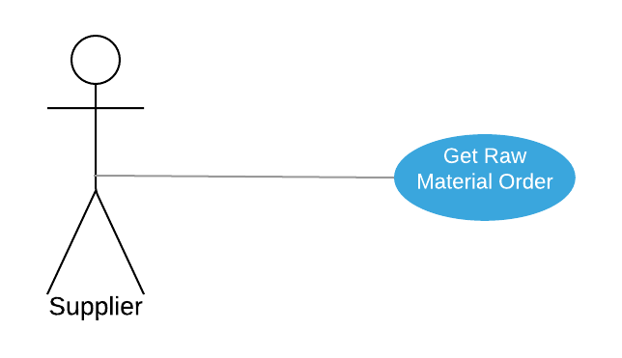
Use case Diagram for Supplier

Slide 7
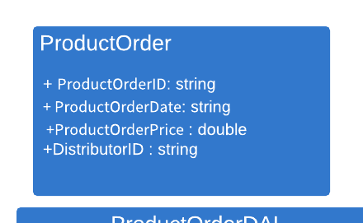
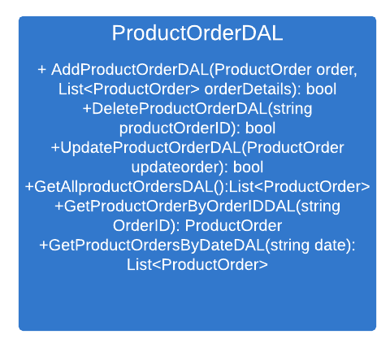
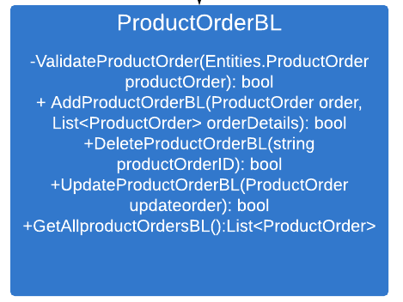
Class diagram of ProductOrder class

Slide 8
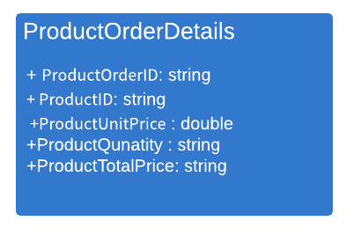
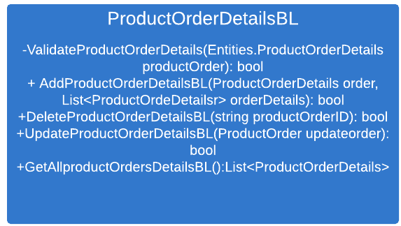
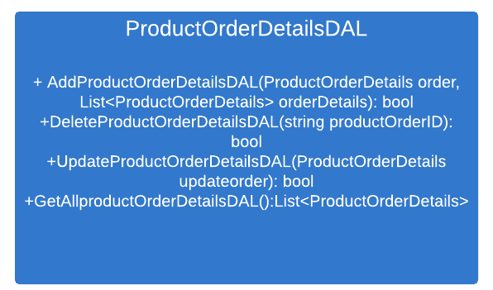
Class diagram of ProductOrderDetails class

Slide 9
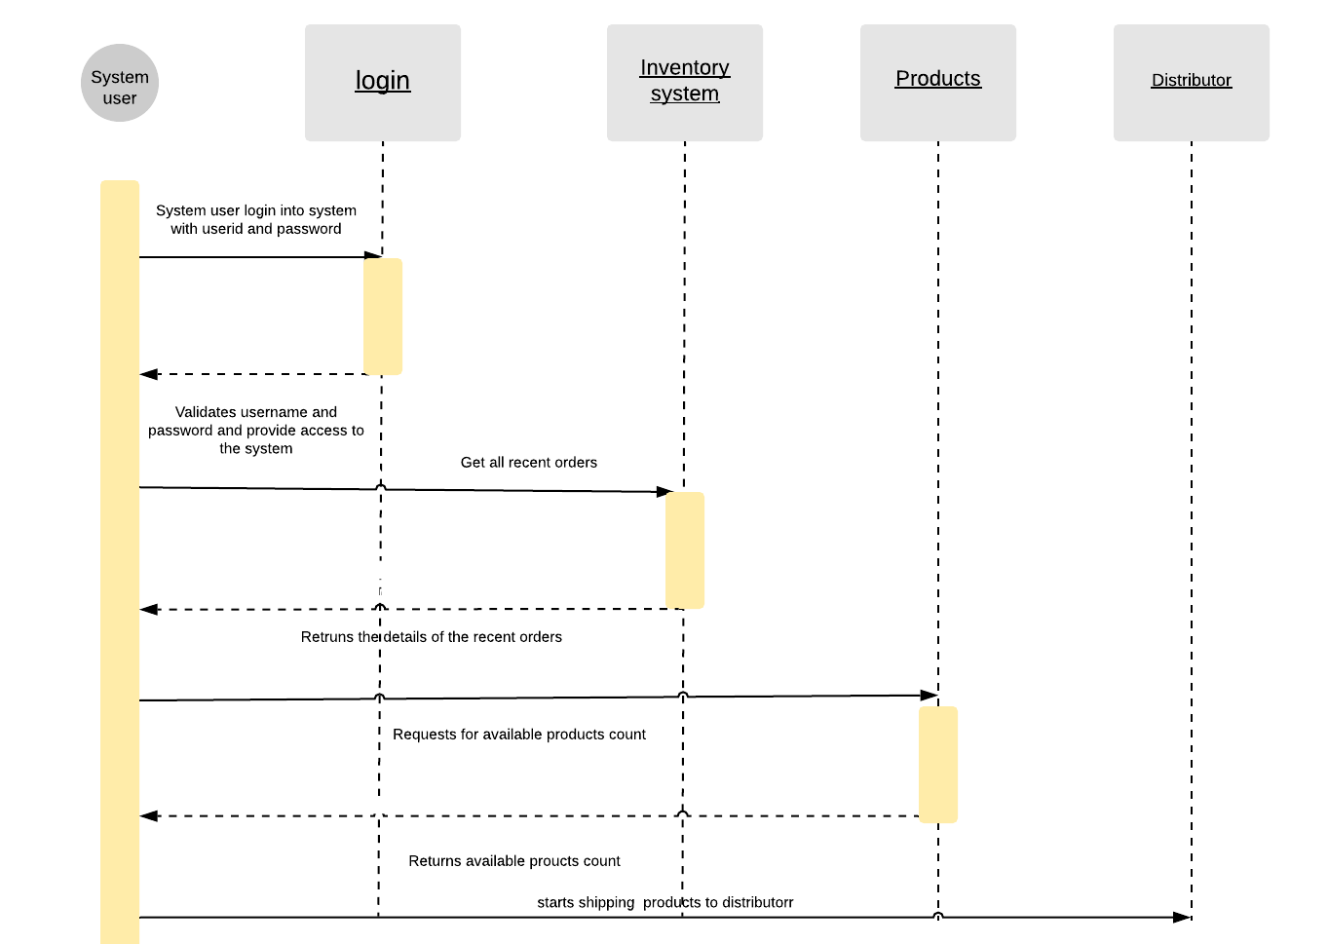
Sequence diagram for order processing by system user

Slide 10
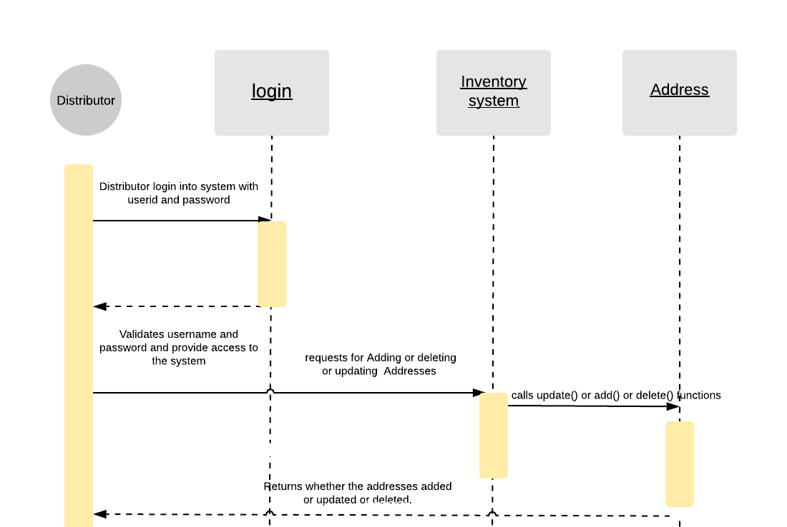
Sequence diagram for managing addresses by the distributor

